Slide 1
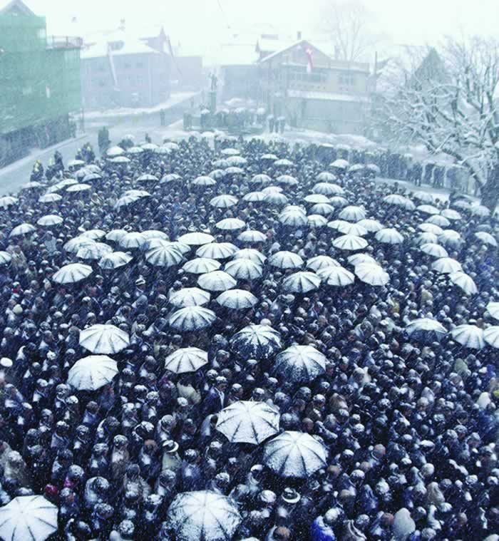

Part I Warm Up
Answer these questions with a partner.
Weather
1. How is the weather in the photo?
cold, snowy, freezing, etc.
2. In your country, how many seasons are there?
3. Which season is your favorite? Why?
\
People gather in the snow to vote in Appenzell-Innerrhoden, Switzerland.

Slide 2
Language Note
Some weather-related words:
hot, cold, warm, freezing
sunny, rainy, snowy, windy, icy, cloudy
hail, snow, rain, sun, cloud
spring, summer, fall/autumn, winter, rainy season/monsoon, dry season
thunderstorm, hailstorm, blizzard, tornado, heatwave, etc.

